Slide 1
CSc 134
Database Management Systems
8. Disk Storage
Ying Jin
Computer Science Department
California state University, Sacramento

Slide 2
Database files
Databases are stored physically as files of records
Storage in disk
How to organize file storage?
How to access files efficiently?

Slide 3
Physical Storage
Primary Storage
  Storage media accessed by CPU directly
Secondary storage
  Data must be copied into primary storage, then the data can be processed by CPU
  Large capacity
  Low cost

Slide 4
Database Storage
Data stored on disk is organized as files of records.
A record is a collection of data values about entities and relationships.
Records should be located efficiently
Primary file organization
  How to placed files of records on the disk physically.
  How to access the records.
  Heap file (unordered files), sorted file, hashed file, B-tree
Secondary organization
  Use alternate fields (other than the fields for primary file organization) to locate records. e.g. index. Ch14

Slide 5
Disk Device
Single-sided / double-sided
Disk pack
Track
Cylinder (tracks with the same diameter on the various surfaces in a disk pack)

Slide 6
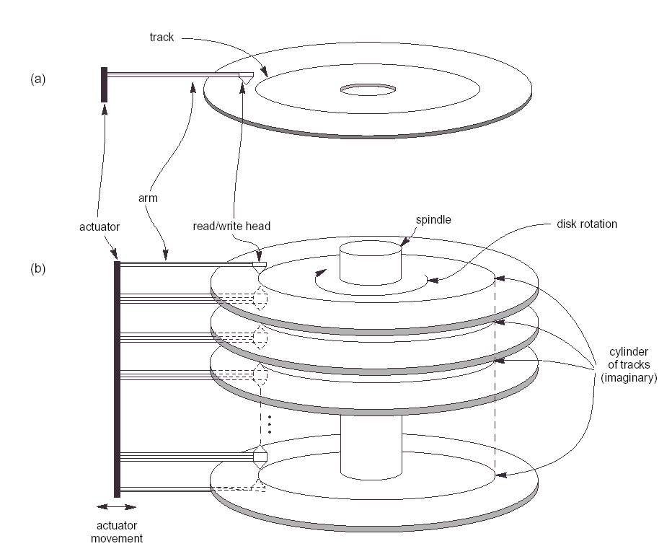

Slide 7
Disk block
Division of a track into equal-sized disk blocks (or pages)
Set by OS during disk formatting
Block size B=512 to 4096 bytes
Blocks are the units transferred between disk and main memory for processing

Slide 8
Disk read/write
A disk or disk pack is mounted in the disk drive
A disk drive includes a motor that rotates the disk
a read/write head includes an electronic component attached to a mechanical arm.
Fixed-head disk
  Head # = track #
  Faster, expensive, not common
Movable-head disk

Slide 9
Disk read/write (cont.)
Disk drive rotates at a constant speed
Move read/write head to position a right track
Electronic component of the read/write head is activated to transfer the data.

Slide 10
Time to read/write
Time =
  Seek time +
    position the correct track
  Rotational delay (Latency) +
    desired block rotates into position under the read/write head
  Block transfer time
    transfer data (much smaller)
More efficient: transfer n consecutive blocks on the same track or cylinder.
Locating data on disk is a major bottleneck

Slide 11
Record
Data is stored in the form of records.
A record consists of a collection of related data values or items.
Record
Multiple fields
<field name, field type>
e.g. Employee record type
employee {SSN char, name char}.
A file is a sequence of records

Slide 12
Fix length Records
Fix-length records:
  Every record in the file has exactly the same size
  e.g. a record size of 71 bytes

Slide 13
Variable-length records
Same record type, but
  variable-length fields
  repeating field: multiple value field for some records
  optional fields
Contain different record types
  e.g. grade_report and student records are clustered.

Slide 14
Record blocking
Records are allocated to disk blocks
One block: many record
Block size: B, record size R
blocking factor bfr=⌞B/R ｣
Floor function: rounds down to an integer
unused space= B – (bfr * R) bytes

Slide 15
Spanned Record
To utilize unused space
  A pointer at the end of the first block points to the block containing the remainder of the record
Must Use spanned organization when a record is larger than one block
Figure

Slide 16
Unspanned
Records are not allow to cross block boundaries
Used in fix-length record
Make each record start at a known location
Variable-length records can be spanned or unspanned.
Figure

Slide 17
File headers
Also named file descriptor
Info about
  disk addresses of the file block
  record format descriptions
    field lengths and order of fields within a record for fixed-length unspanned records
    field type codes, separator characters, and record type codes for variable-length records.

Slide 18
Operations on file
Open
  Prepare the file for reading or writing
  Retrieve file header
  Set file pointer to the beginning of the file
Read (or Get)
  Copies the current record from the buffer to a program variable in the user program
  Current record pointer to the next record

Slide 19
Operations on file (cont.)
Find (or Locate)
  Searches for the first record that satisfies a search condition
  Transfers the block into main memory buffer if not there
findNext
  Search for the next record satisfies the condition
  Transfers the block into main memory buffer if not there

Slide 20
Operations on file (cont.)
Delete
  Delete the current record
  Eventually updates the file on disk to reflect the deletion
Modify
  Modifies some field values for the current record
  Eventually update disk to reflect modification

Slide 21
Operations on file (cont.)
Insert
  Locate the block to be inserted
  transfer that block into a main memory buffer
  insert the record into the buffer
  eventually writing the buffer back to disk to reflect the insertion
Close
  Release the buffers
  Perform any other needed cleanup operations
Reset
  Sets the file pointer of an open file to the beginning of the file.

Slide 22
Operations on file (cont.)
FindAll
  Locates all records satisfy a condition
Find n
  Search for the first record satisfies a search condition
  Locate the next n-1 satisfied record
  Transfer the n record to main memory buffer

Slide 23
Operations of files (Cont.)
FindOrdered
  retrieves all the records in the file in some specific order
Reorganize
  Start the reorganization process
  Some file organization require periodic reorganization
  e.g. reorder on a specified field

Slide 24
Files of unordered records
Also called a heap or a pile file.
New records are inserted at the end of the file.
Record insertion is quite efficient.
Search for a record
  a linear search through the file records is necessary.
  requires reading and searching half the file blocks on the average, and is hence quite expensive.

Slide 25
Files of unordered records (cont.)
Delete
  Leave deleted space empty
  Deletion marker with each record
    Only search/read valid record
  Waste of storage space → requires periodic reorganization
Unordered file can be
  Spanned or unspanned
  Fixed-length or variable-length

Slide 26
Sorted Files
Files of ordered records
File records are kept sorted by the values of an ordering field.
A binary search can be used to search for a record on its ordering field value.
  This requires reading and searching log₂ (b) of the file blocks
  An improvement over linear search (b/2).

Slide 27
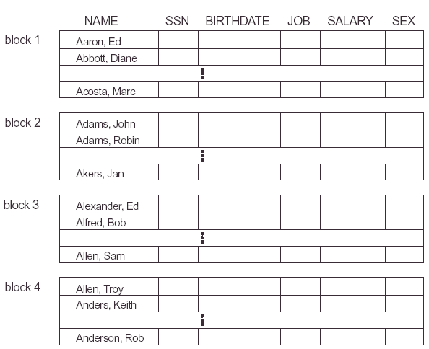

Slide 28
Sorted Files (Cont.)
Reading the records in order of the ordering field is quite efficient.
Provide no advantage on searching non-ordering field
Inserting and deleting is expensive (figure)
Deleting: deletion markers, periodic reorganization
Make insertion more efficient (figure)
  main/master file
  overflow/transaction file

Slide 29
Hashing Techniques

Slide 30
Hashing function
h ( hash field) = address of disk block
Figure
e.g. h(K) = K mod M
Noninteger hash field values can be transformed into integers before the mode function is applied

Slide 31
Collision
Most hash functions do not guarantee that distinct values will hash to distinct addresses
Collision: Hash to an address that already contains a different record
Collision resolution
  Chaining
    A pointer field is added to each record location
    Point to a overflow location

Slide 32
External Hashing
Hashing for disk files is called external hashing
Bucket: one disk block or a cluster of contiguous blocks
h(key)=relative buck #
A Table in file header (relative bucket #, corresponding block address)
Figure

Slide 33
Overflow of bucket
Record pointer: a block address and a relative record position
Figure

Slide 34
Operations on external hashing
Search for non-hash field is expensive
Deletion
  Remove from bucket, move a overflow record to the bucket
  Remove from a overflow bucket. Maintain a linked list of unused overflow locations
Modify
  search to locate the record
  Modify the record
    Non-hash filed: change it, rewrite it in the same bucket
    hash field: move to another bucket: deletion of the old , insert a new.

Slide 35
Problems of Static hashing
Fix number of buckets M
m: maximum # of records per bucket
At most (m*M) records will fit in the allocated space.
More record → collision → long lists of overflow records → retrieve slow down →chose new h based on M → reorganize → time consuming

Slide 36
Hashing techniques allow dynamic file expansion
Allow the dynamic growth and shrinking of the number of file records.
h(field) =result (e.g. 3)
binary representation (a string of bit) of the result. (e.g. 011)
Extendible hashing
Linear Hashing

Slide 37
Extendible Hashing
Directory
  an array of 2^{d} bucket address
  d: global depth
Figure
Local depth d’
  stored with each bucket
  specify the number of bits on which the bucket contents are based

Slide 38
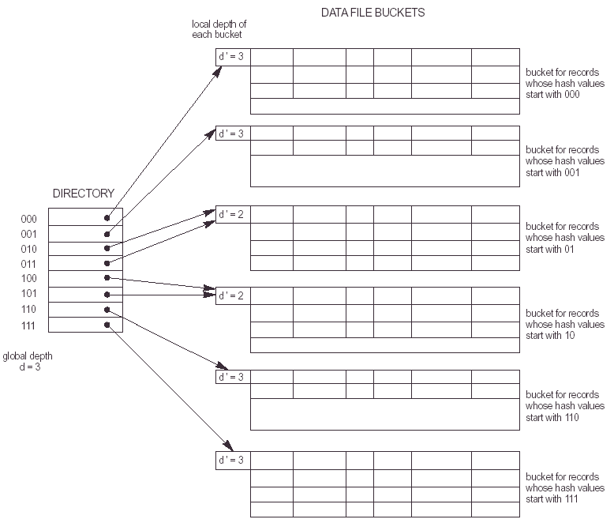

Slide 39
Overflow
insert a new record → overflow in a bucket
  d’<d. figure
  d’=d. figure
    Double directory
    Use extra bit to distinguish the two new buckets.

Slide 40
Two-Phase, Multiway Merge Sort

Slide 41
Two Phases
Phase 1
  Read in and sort main-memory-size pieces of the data
  Write each sorted sublist to disk
Phase 2
  Merge all the sorted sublists into a single sorted list

Slide 42
Phase 2
Read the first block of each sorted sublist into a main-memory buffer.
Find the smallest key among the first remaining elements of all the lists
Move the smallest element to the first available position of the output block
If the output is full, write it to disk and reinitialize the buffer
If the block from which the smallest element was just taken is now exhausted of records, read the next block from the same sorted sublist into the same buffer.
If no blocks remain, then leave its buffer empty and do not consider elements from that list in any further competition for smallest remaining elements.

Slide 43
These slides are based on the textbooks:
R. Elmaseri and S. Navathe, Fundamentals of Database Systems, 7th Edition, Addison-Wesley.
H. Garcia-Molina, J. Ullman, J. Widom, Database System Implementation, 1st Edition, Prentice Hall

